Slide 1
The Fear-Industrial Complex
Classification of fear and other emotions within current US news media
Sam Kolodrubetz, UMBC Spring 2022
DATA 606, Dr. Chaojie Wang

Slide 2
Introduction
Since the 19th century, one phrase has been a centerpiece for how stories are told to the public: “if it bleeds it leads”¹
if a story can scare the audience to coming back for more information, it will be published.
This project is an attempt to quantify the level of fear within current news media, particularly online opinion articles, various news outlets use in their daily reporting.

Slide 3
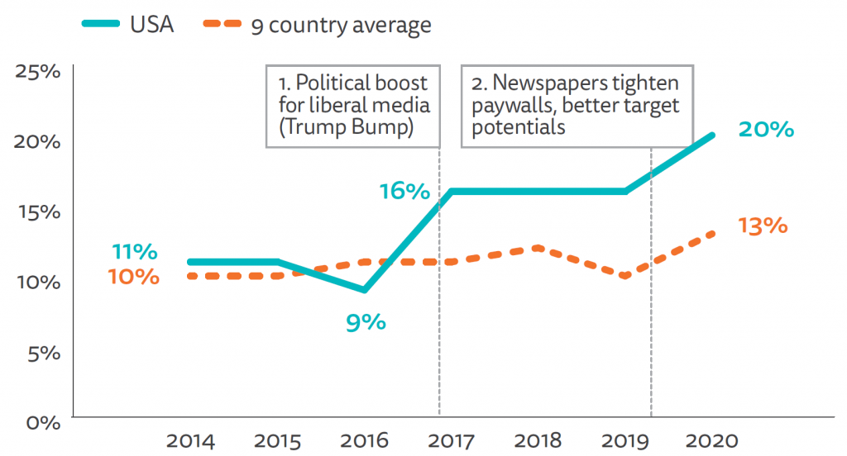
Importance
Understanding how fear is used as a strategy by these outlets is essential in recognizing sensationalized reporting and having the news benefit the viewer rather than viewers falling victim to these tactics.
Digital news consumption has increased greatly in the US and around the world, especially since the start of the Coronavirus pandemic.

Slide 4
Research Questions
Is it possible to quantify the amount of fear (among other emotions) in news articles among various news outlets?
Is there a difference in the levels of fear used between these different outlets?

Slide 5
Methods of Analysis
There are two steps I am taking to investigate the questions of this project:
Perform emotion classification using a Pytorch Recurrent Neural Network (RNN) on a pre-labeled dataset of tweets to train different machine learning models that will classify the tweets based on their label’s emotion.
Use the models created in step 1 on real-world news articles of a particular topic to determine the amount of fear (among other emotions) are used on various news outlets.

Slide 6
Project Outline
1. Data Cleaning & Preprocessing
4. Web Scrape – Obtain title and first paragraph from real-world articles
2. EDA
Understanding how the words build into each class
3. Model Creation – Create ML model and train/test on labeled data.
5.Transfer Learning – Classify emotions used in real-world articles

Slide 7
Data Preprocessing
“I was feeling a little low a few days back”
[“I”, “was”, “feeling”, “a”, “little”, “low”, “a”, “few”, “days”, “back”]
[“feeling”, “little”, “low”, “days”, “back”]
[“feel”, “little”, “low”, “day”, “back”]
Original Sentence
Tokenized
No Stop Words
Lemmatized

Slide 8
Data Preprocessing
Several more steps are needed before Pytorch can effectively load and process the data:
Dictionary Creation – The dictionary is a list of all emotions contained in the dataset and the individual (transformed) tweets that correspond to that emotion.
Vocabulary Creation – The dataset’s vocabulary contains all unique words and an assigned index.

Slide 9
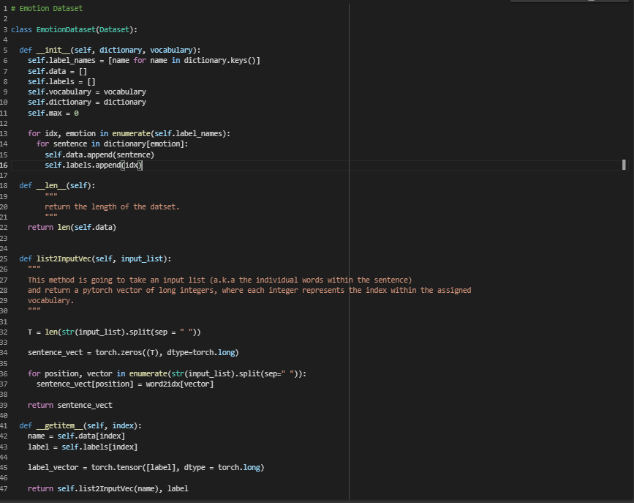
Dataset Creation
[“feel”, “little”, “low”, “day”, “back”]
Words changed into a format Pytorch Datasets can work with
[3, 8, 14, 175, 1020]

Slide 10
Data Source - RNN Training
The data comes from huggingface.co², and contains 416,809 entries with 2 columns:
Text - the (partially) cleaned text of the tweets gathered by the authors of the dataset.
Emotions - the label of the tweet, which is one of 6 emotions: fear, anger sadness, joy, love and surprise.

Slide 11
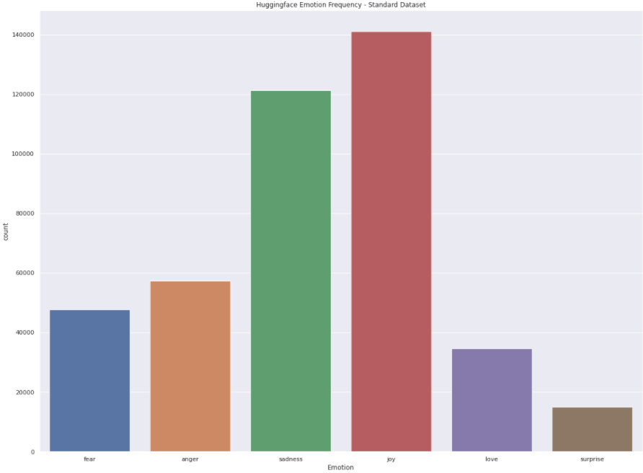
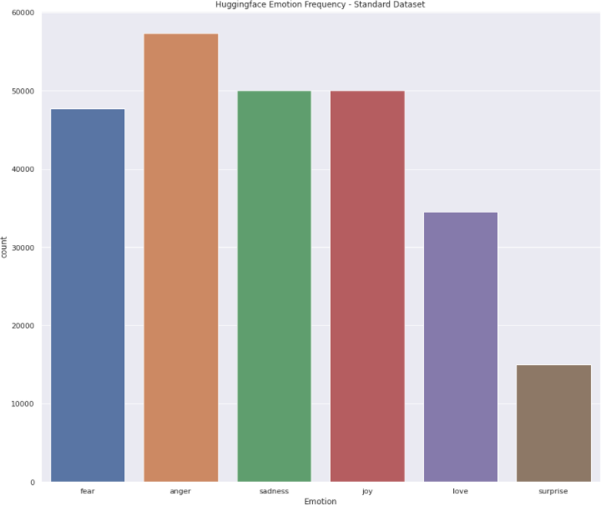
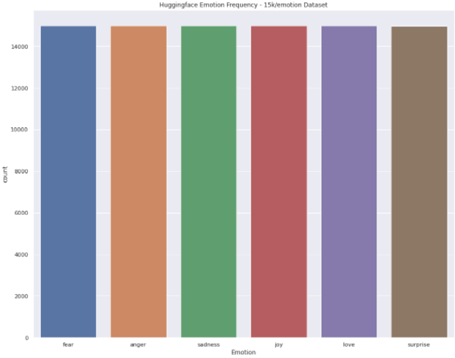
Imbalanced Data
Fear Anger Sad Joy Love Surprise
Fear Anger Sad Joy Love Surprise
Fear Anger Sad Joy Love Surprise
Original Dataset –
416,806 total samples
Downsampled Dataset –
254,555 total samples
Even Dataset – 89,972 total samples

Slide 12
Dataset Support
Emotion | Full Dataset | 50 K Dataset | 15K – Even Dataset
Fear | 47,712 | 47,712 | 15,000
Sadness | 121,187 | 50,000 | 15,000
Anger | 57,317 | 57,317 | 15,000
Joy | 141,067 | 50,000 | 15,000
Surprise | 14,972 | 14,972 | 14,972
Love | 34,554 | 34,554 | 15,000
Total | 416,806 | 254,555 | 89,972

Slide 13
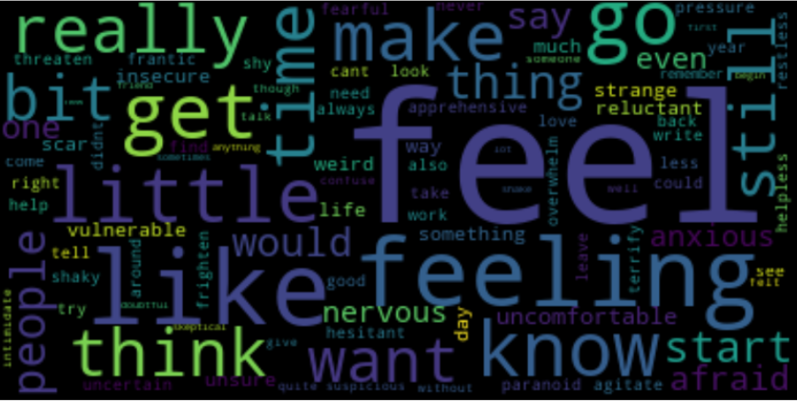
Stop Words
Several words, namely “feel”, “know”, and “think” are very prevalent within the input dataset. This lead me to compare the performance of models with datasets with and without these words.

Slide 14
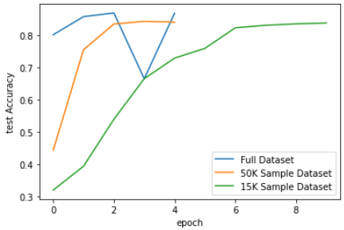
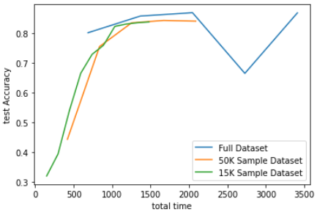
ML – RNN Results (Batch Size = 1)

Slide 15
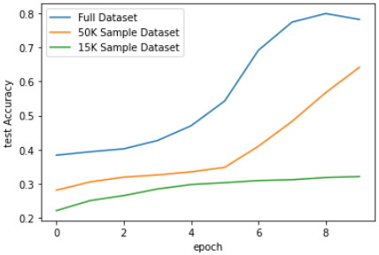
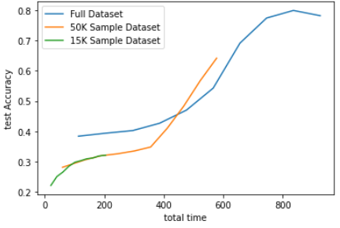
ML – RNN Results (Batch Size = 16)

Slide 16
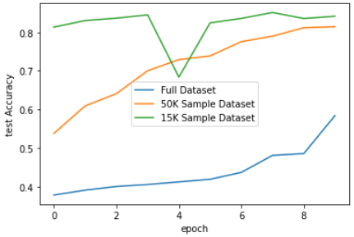
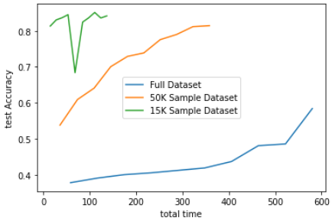
ML – RNN Results (Batch Size = 32)

Slide 17
Results Table – Batch Size
Batch Size = 1
Batch Size = 16
Batch Size = 32
Dataset | Test Accuracy | Training Time (Minutes)
Full Dataset | 83.4% | 54.2
50K Samples | 79.9% | 36.7
15K Samples | 80.1% | 23.3
Dataset | Test Accuracy | Training Time (Minutes)
Full Dataset | 77.1% | 14.3
50K Samples | 62.1% | 9.5
15K Samples | 29.6% | 3.4
Dataset | Test Accuracy | Training Time (Minutes)
Full Dataset | 59.4% | 9.7
50K Samples | 77.5% | 5.8
15K Samples | 81.1% | 2.1

Slide 18
Results Table – Stop Word Deletion
Dataset | Test Accuracy | Training Time (Minutes)
Additional Stop Words Used | 60.1% | 22
Standard Dataset | 82.7% | 22
To test whether deleting additional stop words would impact testing, 10 words such as “feel”, “get”, “really”, and “go” were deleted from each input vector. The new dataset was trained, tested, and compared to a similar model.
In previous iterations, the difference in the accuracy of each model was less drastic. But the last one run had a higher difference.

Slide 19
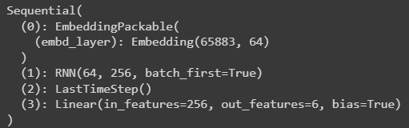
Final RNN Used
Dataset – 15,000 sample balanced dataset
Batch size = 32
No additional stop words added
Softmax output function
Trained for 25 epochs
Final Test Accuracy: 82.5%

Slide 20
Results – Web Scrape
 | Fox News | CNN | Total
# Articles Scraped | 27 | 130 | 157
Avg. Words/ Article | 599 | 876 | 828
Vocabulary Length |  |  | 15,062
The websites tested were obtained from both CNN and Fox News by using newspaper3k and include only opinion articles as they tend to use more sensationalized language.
Each input article went through a similar preprocessing step as the tweet dataset (tokenization, lemmatization, transformed to tensors) to be recognized by the final model.
An overview of the data scraped from CNN and Fox News

Slide 21
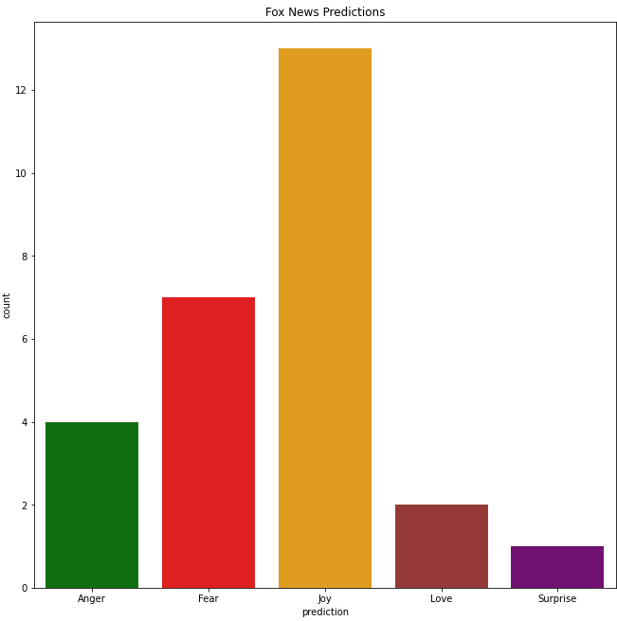
Results – Fox News
Joy is the largest predicted emotion among the small sample size of Fox News, but fear follow as the second emotion with about half the samples. Sadness was not predicted once.

Slide 22
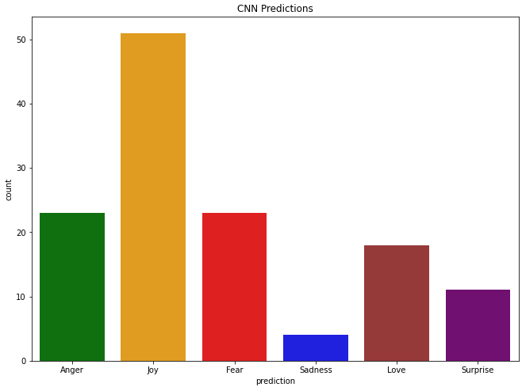
Results - CNN
Similar to Fox News, joy is the largest
fear and surprise are the most represented emotions within the CNN articles scraped.

Slide 23
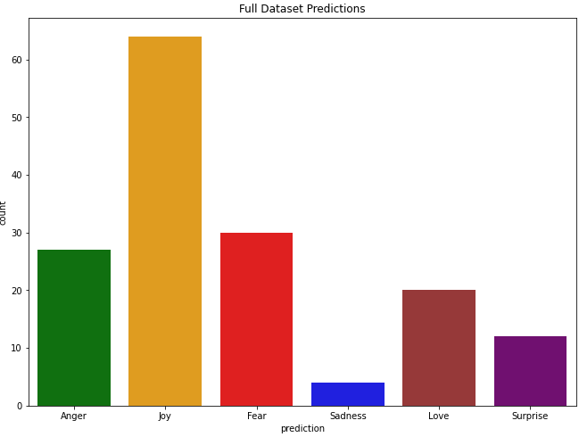
Results – CNN & Fox News
The overall dataset contains very similar observations from each individual site, where joy is by far the highest, followed by anger and fear.

Slide 24
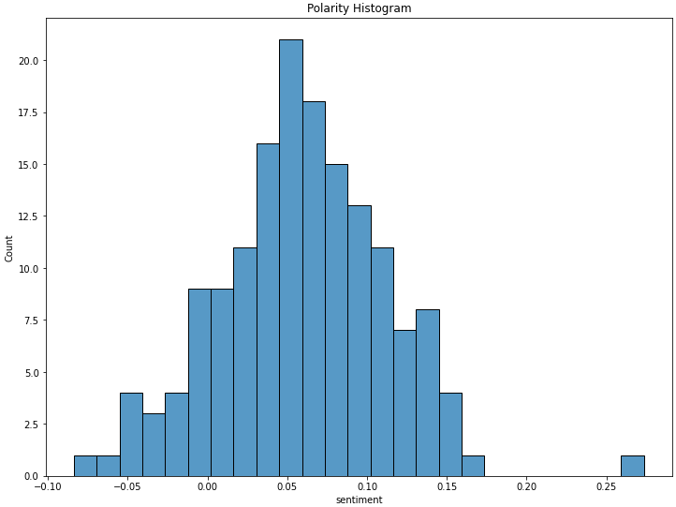
Results –Polarity Histogram
Since joy was such a popular choice for each article’s emotion, it is no surprise the polarity skews towards the positive side. There still are, however, several negative-polarity samples

Slide 25
The Emotion Index
A Softmax function returns a list of decimal numbers for each class that represents the models prediction of which emotion the input tensor is. The function will return the highest probability and return that as the prediction, throwing away the other numbers.
The emotion index was created to level of fear (and other emotions) predicted even when it wasn't the highest-predicted emotion to capture how popular of a 2nd or 3rd choice fear (as well as other emotions are)
With 6 emotions a plurality is around 16%, so if most of the predictions fall around this point, this is an interesting complication that would mean extremely strong predictions were not made across the articles.

Slide 26
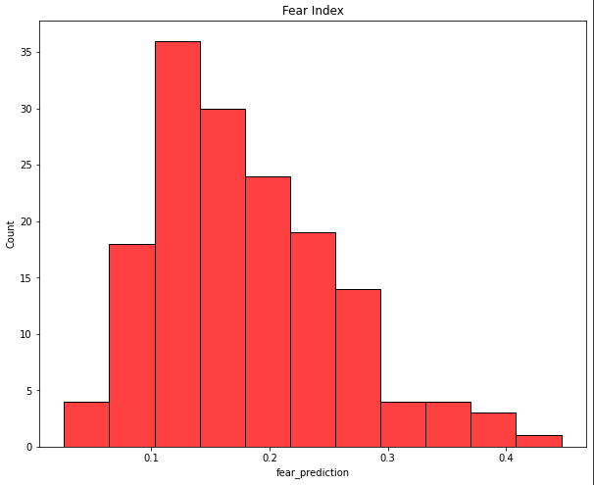
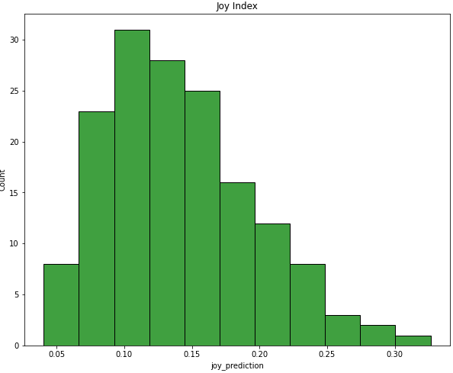
Emotion Index – Fear and Joy
Fear and Joy follow roughly the same distribution, having a large portion of their values centered at 0.15.

Slide 27
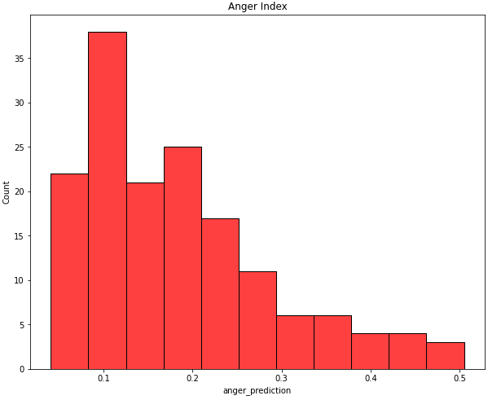
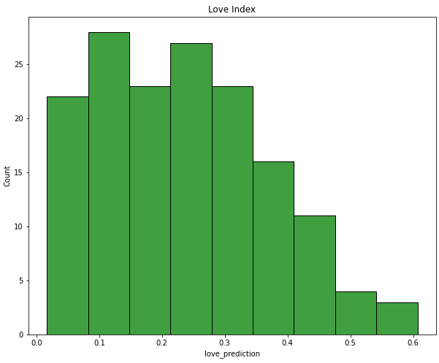
Emotion Index – Anger and Love
Anger has many of its values between 0.1-0.25, and the distribution for love has substantially more values at a higher range.

Slide 28
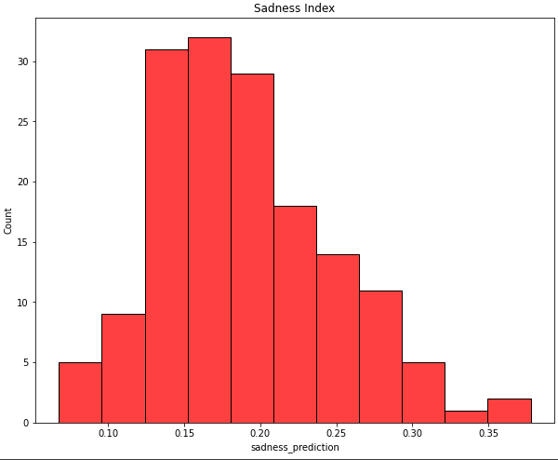
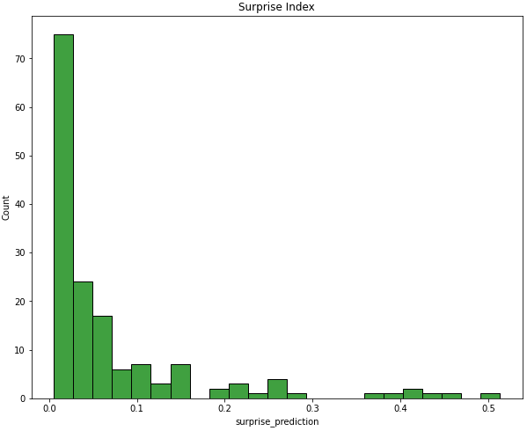
Emotion Index – Sadness and Surprise
We can see now that all negative emotions are following roughly the same distribution still. Surprise is the only emotion where most of the scores are around 0-0.1, with only the correct predictions having high values.

Slide 29
Conclusions
1. Is fear used more than other emotions within news articles?
Among this sample of news articles from Fox News and CNN, joy was the highest-predicted emotion by far for both news sites. Fear and anger followed, having about half the amount of predictions as joy. Sadness was by far the least-predicted emotion.
2. Is there a difference in the levels of fear used between different media outlets?
From the collected articles, despite a different sample size, both Fox News and CNN had about the same distribution of emotion predictions. There is not a clear difference.

Slide 30
References
https://abcnews.go.com/2020/story?id=2898636&page=1
https://www.chicagotribune.com/news/ct-xpm-1989-11-05-8901280504-story.html
https://huggingface.co/datasets/emotion/viewer/default/train
https://ieeexplore.ieee.org/stamp/stamp.jsp?arnumber=868103
https://github.com/EdwardRaff/Inside-Deep-Learning
cnn.com
foxnews.com

